Slide 1
Concurrency Control

Slide 2
Concurrency Control
T1 | T2

Slide 3
Concurrency Control
Concurrency control mechanism is responsible for maintaining the database consistency in case of concurrent execution.
Following are the most common concurrency control protocols:
Lock based protocol
Time stamp based protocol
Validation based protocol

Slide 4
Lock-Based Protocols
Inconsistency occurs when two transactions attempt to modify the same data item at the same time.
A general solution to this problem is that, if one transaction is accessing a data item then, no other transaction should be allowed to modify that data item.
Locks are used to implement this general solution.
Lock- is a variable associated with each data item that describes the status of the item with respect to possible operations that can be applied to it.

Slide 5
Locks
There are two types of locks:
Binary locks
Shared/Exclusive locks
A binary lock can have two states-locked and unlocked.
The function lock(X) tells that whether data item X is locked or not at a given time.
If lock(X)=1 then, X is locked and if lock(X)=0 then, X is not locked.
A transaction can request and release a lock on data item X by using following two instructions:
Lock_item(X)
unlock_item(X)

Slide 6
Locks
Main drawback of binary lock is that at a given point of time, at most one transaction can hold a lock on data item X. But, in database system it should be allowed that multiple transactions may access a data item only for reading.
To overcome this problem, we use shared/exclusive lock.

Slide 7
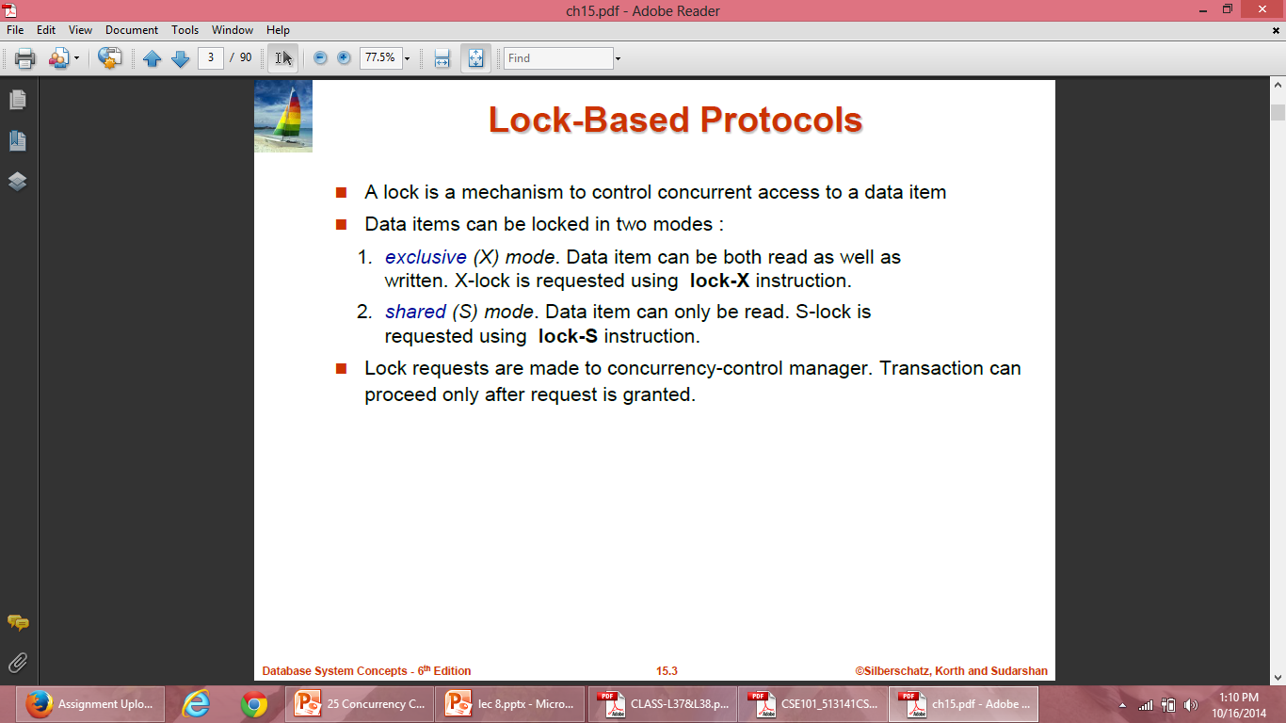
Locks

Slide 8
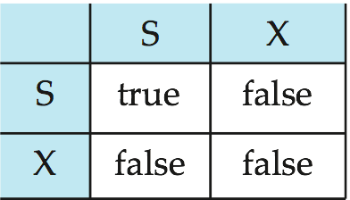
Lock-Based Protocols (Cont.)
Lock-compatibility matrix
A transaction may be granted a lock on an item if the requested lock is compatible with locks already held on the item by other transactions.
Any number of transactions can hold shared locks on an item,
but if any transaction holds an exclusive on the item no other transaction may hold any lock on the item.
If a lock cannot be granted, the requesting transaction is made to wait till all incompatible locks held by other transactions have been released. The lock is then granted.

Slide 9
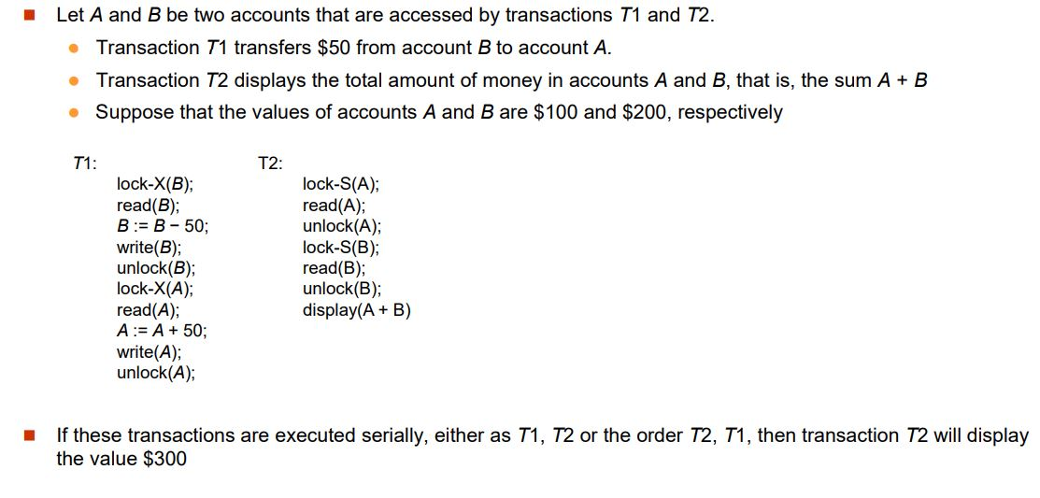
Lock-Based Protocols (Cont.)

Slide 10
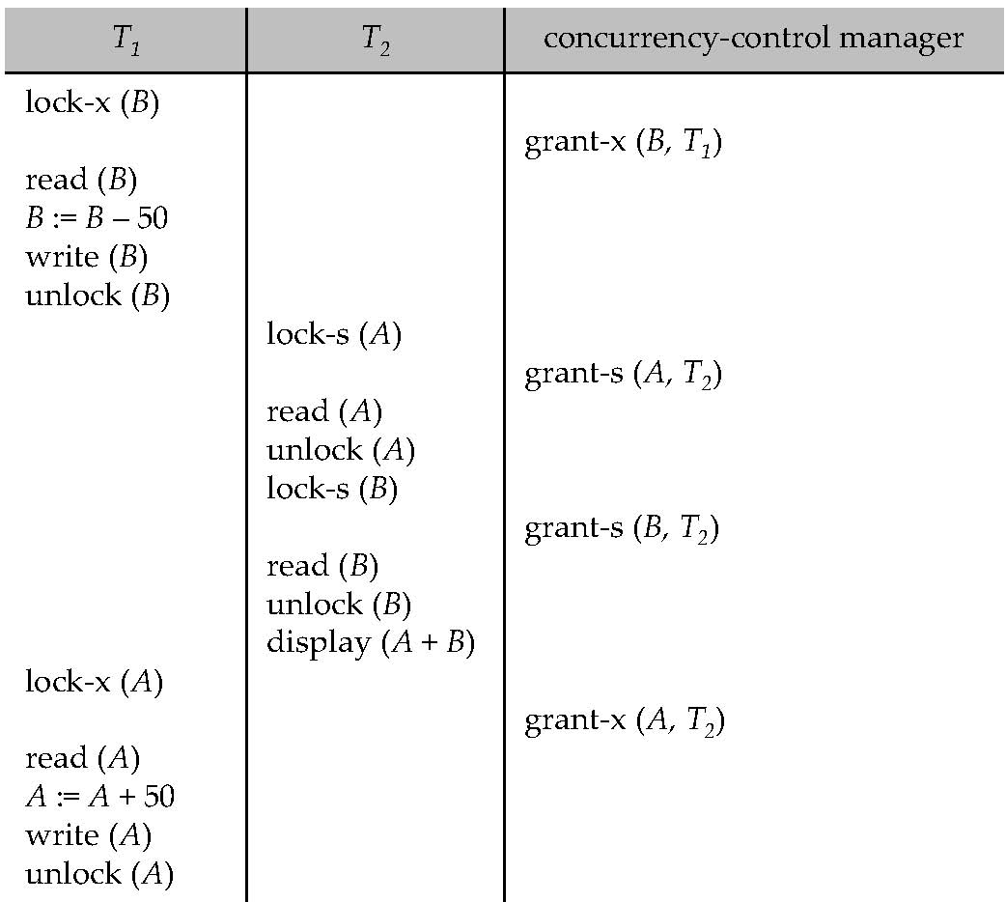
Locks
In this case, transaction T2 displays $250, which is incorrect. The reason for this mistake is that the transaction T1 unlocked data item B too early, as a result of which T2 saw an inconsistent state.

Slide 11
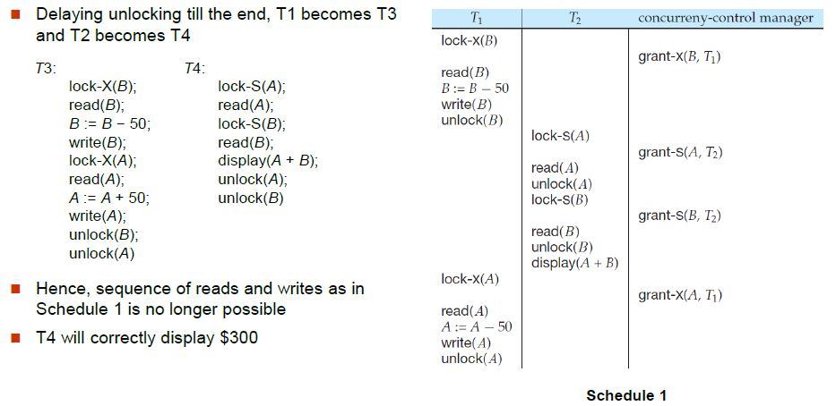
Locks

Slide 12
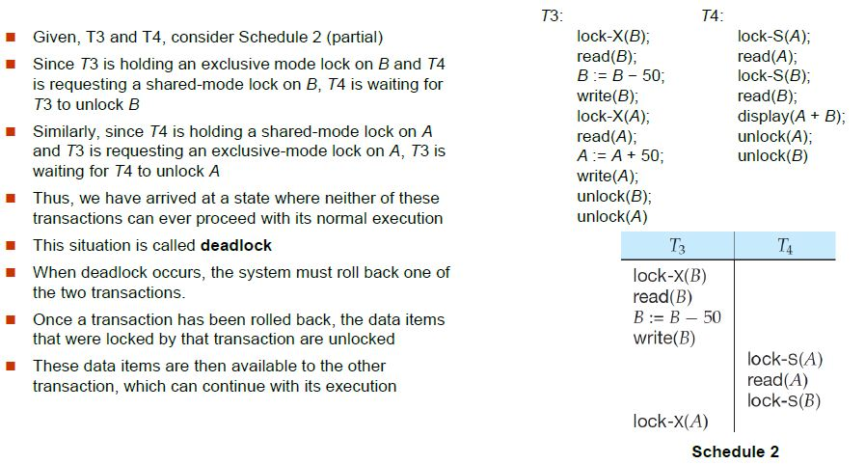
Pitfalls of Lock-Based Protocols

Slide 13
Pitfalls of Lock-Based Protocols
When a transaction requests a lock on data item in a particular mode, and no other transaction has a lock on the same data item in a conflicting mode, the lock can be granted. However, care must be taken to avoid the following scenario.
A transaction may be waiting for an X-lock on an item, while a sequence of other transactions request and are granted an S-lock on the same item. (Problem of Starvation )

Slide 14
Pitfalls of Lock-Based Protocols
T1 | T2 | T3 | T4
 | S(A)
X(A) | .
. | .
. | .
. | . | S(A)
. | . | .
. | U(A) | .
. |  | . | S(A)
. |  | . | .
. |  | U(A) | .
. |  |  | U(A)

Slide 15
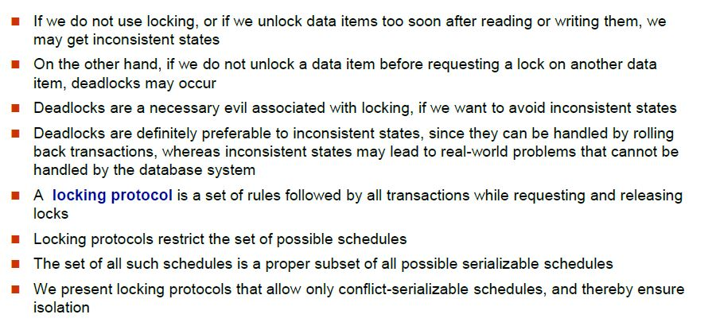
Lock Based Protocols

Slide 16
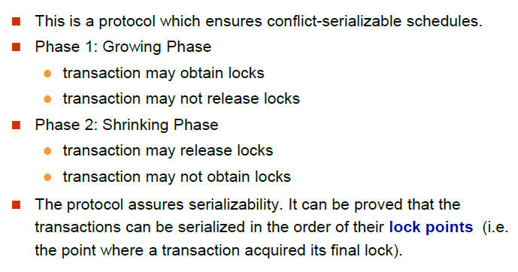
The Two-Phase Locking Protocol

Slide 17
The Two-Phase Locking Protocol
T1 | T2
X(A)
R(A)
W(A)
 | R(A)
S(B)
R(B)
U(A)
.
U(B)
T1 | T2
Lock S(A)
 | Lock S(A)
Lock X(B)
Unlock(A)
. | Lock X(C)
. | .
Unlock (B) | Unlock(A)
 | .
 | Unlock (D)

Slide 18
The Two-Phase Locking Protocol
Cascading rollback may occur in Two phase locking so in order to avoid it three variations on two phase locking is used:
Strict two-phase locking : Here a transaction must hold all its exclusive locks till it commits/aborts.
Rigorous two-phase locking : is even stricter: here all locks are held till commit/abort. In this protocol transactions can be serialized in the order in which they commit.

Slide 19
Time Stamp Based Protocol
Each transaction is issued a timestamp when it enters the system. If an old transaction Ti has time-stamp TS(Ti), a new transaction Tj is assigned time-stamp TS(Tj) such that TS(Ti) <TS(Tj).
The protocol manages concurrent execution such that the time-stamps determine the serializability order.
In order to assure such behavior, the protocol maintains for each data Q two timestamp values:
W-timestamp(Q) is the largest time-stamp of any transaction that executed write(Q) successfully.
R-timestamp(Q) is the largest time-stamp of any transaction that executed read(Q) successfully.

Slide 20
Time Stamp Based Protocol
Use the value of the system clock as the timestamp; that is, a transaction’s timestamp is equal to the value of the clock when the transaction enters the system.
Use a logical counter that is incremented after a new timestamp has been assigned; that is, a transaction’s timestamp is equal to the value of the counter when the transaction enters the system.

Slide 21
Time Stamp Based Protocol
The timestamp ordering protocol ensures that any conflicting read and write operations are executed in timestamp order.
Suppose a transaction Ti issues a read(Q)
If TS(Ti) < W-timestamp(Q), then Ti needs to read a value of Q that was already overwritten. Hence, the read operation is rejected, and Ti is rolled back.
If TS(Ti)≥ W-timestamp(Q), then the read operation is executed, and R-timestamp(Q) is set to max(R-timestamp(Q), TS(Ti)).

Slide 22
Time Stamp Based Protocol
Suppose that transaction Ti issues write(Q).
If TS(Ti) < R-timestamp(Q), then the value of Q that Ti is producing was needed previously, and the system assumed that that value would never be produced. Hence, the write operation is rejected, and Ti is rolled back.
If TS(Ti) < W-timestamp(Q), then Ti is attempting to write an obsolete value of Q. Hence, this write operation is rejected, and Ti is rolled back.
Otherwise, the write operation is executed, and W-timestamp(Q) is set to TS(Ti).

Slide 23
Example
T1 (TS(T1)=10) | T2 (TS(T2)=20) | T3 (TS(T3)=30)
R(A)
 | R(B)
W(C)
 |  | R(B)
R(C)
 | W(B)
 |  | W(A)
A
B
C
RTS
0
0
0
WTS
0
0
0

Slide 24
Time Stamp Based Protocol: Example
To illustrate this protocol, we consider transactions T₁ and T₂. Transaction T₁ displays the contents of accounts A and B:
T₁:
read(B);
read(A);
display(A + B);
T₂:
read(B);
B := B − 50;
write(B);
read(A);
A := A + 50;
write(A);
display(A + B);

Slide 25
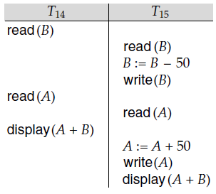
Time Stamp Based Protocol
In presenting schedules under the timestamp protocol, we shall assume that a transaction is assigned a timestamp immediately before its first instruction. Thus, in schedule 3, TS(T₁) < TS(T₂), and the schedule is possible under the timestamp protocol.
Schedule 3

Slide 26
Thomas Write Rule
Modified version of the timestamp-ordering protocol in which obsolete write operations may be ignored under certain circumstances.
When Ti attempts to write data item Q, if TS(Ti) < W-timestamp(Q), then Ti is attempting to write an obsolete value of {Q}.
Rather than rolling back Ti as the timestamp ordering protocol would have done, this {write} operation can be ignored.
Otherwise this protocol is the same as the timestamp ordering protocol.

Slide 27
Validation Based Protocol
We assume that each transaction T_{i} executes in two or three different phases in its lifetime, depending on whether it is a read-only or an update transaction. The phases are, in order,
Read phase. During this phase, the system executes transaction T_{i}. It reads the values of the various data items and stores them in variables local to T_{i}. It performs all write operations on temporary local variables, without updates of the actual database.

Slide 28
Validation Based Protocol
Validation phase. Transaction T_{i} performs a validation test to determine whether it can copy to the database the temporary local variables that hold the results of write operations without causing a violation of serializability.
Write phase. If transaction T_{i} succeeds in validation (step 2), then the system applies the actual updates to the database. Otherwise, the system rolls back T_{i}.

Slide 29
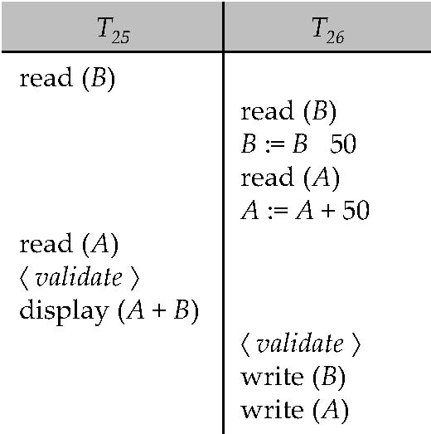
Validation Based Protocol
Each transaction Ti has 3 timestamps
Start(Ti) : the time when Ti started its execution
Validation(Ti): the time when Ti entered its validation phase
Finish(Ti) : the time when Ti finished its write phase

